Slide 1
Intel Ethernet Flow Director
研究报告
2021.03.17
李春利

Slide 2
需求背景:
2020年 10月 国庆期间, iOS/Android 微信客户端升级 UDP 0x97,0x11 报文开始广泛应用
话单UDP 0x97,0x11报文特点:
1) 报文很短, 约100~110字节
2) 报文频率高, 单端C2S+S2C≈220pkt/s (81858pkt÷372s≈220 2021.02.24 iOS测得)
3) 报文需要做衰减处理, 但序号位置超出8字节匹配范围
新的问题:
1) 话单 UDP 报文短, 频率高, 序号远.
2) 难以收包 + 过滤 + 解析.

Slide 3
wxa 报文格式
UDP 数据格式
data.data[0]==d5
data.data[0]==75
data.data[0]==95
data.data[0:2]==76:03
data.data[0:2]==77:03
data.data[0:2]==97:11
UDP端口
udp.port==80
udp.port==8000
udp.port==8080
udp.port==16285
会话控制:
D5
XX
XX
XX
XX
XX
XX
XX
XX
XX
XX
XX
前缀
个人通话:
75
00
01
00
00
00
00
67
3B
FE
FD
00
XX
XX
XX
XX
前缀
序号
保留
会话标识
主被叫
个人通话:
97
11
00
00
00
00
17
8B
BE
8F
00
00
00
01
XX
XX
XX
XX
前缀
保留
会话标识
主被叫
序号
群组通话:
76
03
00
01
17
8B
BE
8F
XX
XX
XX
XX
前缀
序号
会话标识
群组通话:
77
03
00
01
17
8B
BE
8F
XX
XX
XX
XX
前缀
序号
会话标识
群组通话:
95
00
01
00
00
00
00
17
8B
BE
8F
00
00
00
00
XX
XX
XX
XX
前缀
序号
保留
会话标识
保留

Slide 4
Intel Ethernet Flow Director ?
Introduction
Intel Ethernet FD supports advanced filters that direct received packets to different queues, and enables tight control on flow in the platform. It matches flows and CPU cores where the processing application is running for flow affinity, and supports multiple parameters for flexible flow classification and load balancing. When operating in Application Targeting Routing (ATR) mode, Intel Ethernet FD is essentially the hardware offloaded version of Receive Flow Steering available on Linux* systems, and when running in this mode, Receive Packet Steering and Receive Flow Steering are disabled.
It provides the most benefit on Linux bare-metal usages (that is, not using virtual machines (VMs)) where packets are small and traffic is heavy. And because the packet processing is offloaded to the network interface card (NIC), Intel Ethernet FD could be used to avert denial-of-service attacks.
Supported Devices
Intel Ethernet FD is supported on devices that use the ixgbe driver, including the following:
Intel® Ethernet Converged Network Adapter X520
Intel® Ethernet Converged Network Adapter X540
Intel® Ethernet Controller 10 Gigabit 82599 family
It is also supported on devices that use the i40e driver:
Intel® Ethernet Controller X710 family
Intel® Ethernet Controller XL710 family

Slide 5
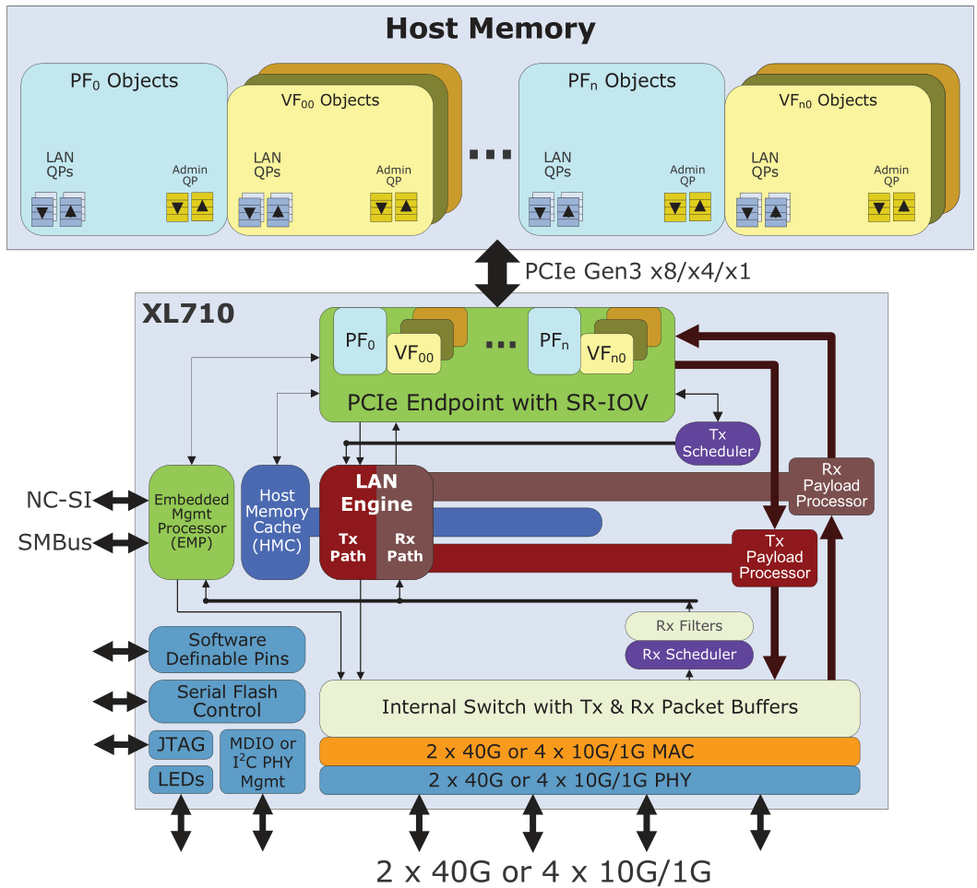
X710 硬件顶层视图

Slide 6
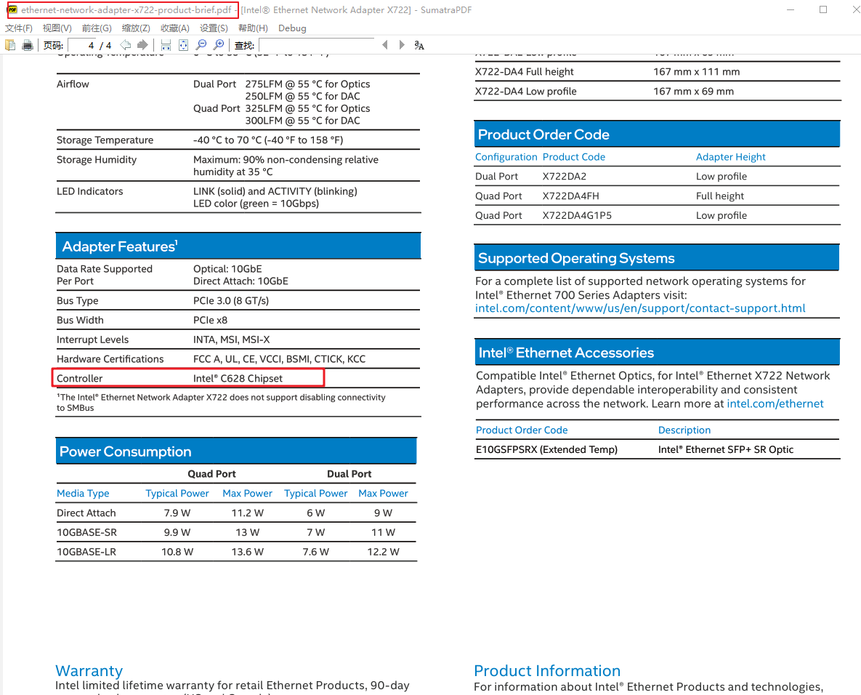
X722 数据 参考手册
X722 网卡 被广泛用于 华为,戴尔,浪潮,联想服务器中
直接在 网上找 X722 datesheet, 是找不到的
X722 网卡被集成在 C628 南桥中
C628 芯片手册 在 C620 手册中.
所以 直接查找 C620 的datesheet 即可.

Slide 7
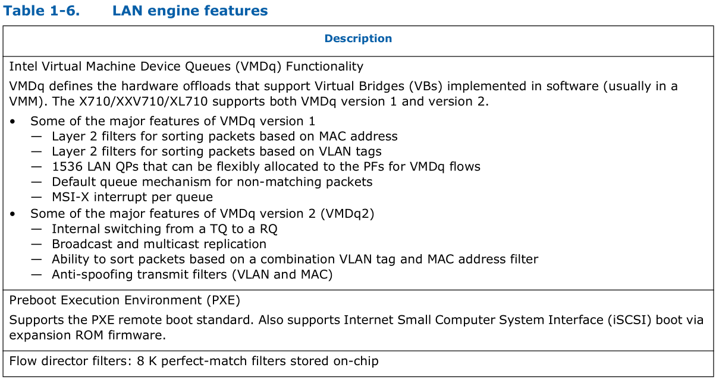
Flow Director 规则上限

Slide 8
Flow Director 解析范围

Slide 9
Flow Director Flexible Payload 匹配范围

Slide 10
Flow Director 适用场景
根据 地址/端口 过滤
ETH/IPV4/TCP -> action(queue, drop)
ETH/IPV6/TCP -> action(queue, drop)
ETH/IPV4/UDP -> action(queue, drop)
ETH/IPV6/UDP -> action(queue, drop)

Slide 11
Flow Director 适用场景
根据 报文负载的前16字节内容 过滤
ETH/IPV4/TCP/RAW -> action(queue, drop)
ETH/IPV6/TCP/RAW -> action(queue, drop)
ETH/IPV4/UDP/RAW -> action(queue, drop)
ETH/IPV6/UDP/RAW -> action(queue, drop)
spec[] = {0x97, 0x11, 0x00, 0x00, 0x00, 0x00, 0x00, 0x00, 0x00, 0x00, 0x00, 0x00, 0x00, 0x00};
mask[] = {0xff, 0xff, 0x00, 0x00, 0x00, 0x00, 0x00, 0x00, 0x00, 0x00, 0x00, 0x00, 0x00, 0x3f};
spec[] = {'G', 'E', 'T', ' ', '/', 'i', 'n', 'd', 'e', 'x', '.', 'h', 't', 'm', 'l' };
mask[] = {0xff, 0xff, 0xff, 0xff, 0xff, 0xff, 0xff, 0xff, 0xff, 0xff, 0xff, 0xff, 0xff, 0xff, 0xff};

Slide 12
Flow Director 适用场景
支持 GTP
ETH/{IPV4/IPV6}/GTP/{IPV4/IPV6} -> action(queue, drop)
E810网卡 支持更长 ✓
ETH/{IPV4/IPV6}/GTP/{IPV4/IPV6}/{TCP/UDP} -> action(queue, drop)
ETH/{IPV4/IPV6}/GTP/{IPV4/IPV6}/{TCP/UDP}/RAW -> action(queue, drop)

Slide 13
Flow Director 不足 (类型)
i40e 驱动不支持 GTP 隧道内匹配 传输层
ETH/{IPV4/IPV6}/GTP/{IPV4/IPV6}/{TCP/UDP} -> action(queue, drop)
ice 驱动不支持 GTP 隧道内 匹配 传输层的负载
ETH/{IPV4/IPV6}/GTP/{IPV4/IPV6}/{TCP/UDP}/RAW -> action(queue, drop)

Slide 14
Flow Director 不足(掩码限制)
RTE_FLOW_ITEM_TYPE_RAW 的掩码限制
当掩码长度相同, 掩码bit相同, 可以创建多条规则.
./testpmd -l 0-9 -n 4 -- -i --nb-cores=8 --rxq=4 --txq=4 --disable-rss --pkt-filter-mode=perfect
flow create 0 ingress pattern eth / ipv4 / tcp / raw relative is 1 offset is 0 pattern is POST / end actions queue index 1 / end
flow create 0 ingress pattern eth / ipv4 / tcp / raw relative is 1 offset is 0 pattern is HEAD / end actions queue index 1 / end
#OK
当掩码不同, 无法创建规则.
./testpmd -l 0-9 -n 4 -- -i --nb-cores=8 --rxq=4 --txq=4 --disable-rss --pkt-filter-mode=perfect
flow create 0 ingress pattern eth / ipv4 / tcp / raw relative is 1 offset is 0 pattern is POST / end actions queue index 1 / end
flow create 0 ingress pattern eth / ipv4 / tcp / raw relative is 1 offset is 0 pattern is ABC / end actions queue index 1 / end
#ERR

Slide 15
Flow Director 不足(优先级)
ixgbe, i40e 均不支持 规则优先级
当掩码长度相同, 掩码bit相同, 可以创建多条规则.
[root@localhost app] ./testpmd -l 0-9 -n 4 -- -i --nb-cores=8 --rxq=4 --txq=4 --disable-rss --pkt-filter-mode=perfect
testpmd> flow create 0 priority 1 ingress pattern eth / ipv4 / tcp / raw relative is 1 offset is 0 pattern is POST / end actions queue index 1 / end
Caught error type 4 (priority field): cause: 0x7ffc6d678418, Not support priority.: Invalid argument
ice驱动(E810网卡) 支持规则的优先级
没有规则的优先级, 就没有办法实现 像iptables 默认策略(drop)

Slide 16
Flow Director 不足(规则数)
只支持 8K 条, 不能超越限制.

Slide 17
参考文献
testpmd_app_ug-18.11.pdf
332464-710_Series_Datasheet_v_3_9.pdf
ethernet-network-adapter-x722-product-brief.pdf
c620-series-chipset-datasheet.pdf
dpdk-readthedocs-io-en-latest.pdf
How to Set Up Intel® Ethernet Flow Director
源码:
dpdk-20.08.tar.xz
dpdk-18.11.11.tar.xz

